Slide 1

Psychopharmacology: Drugs, the Brain, and Behavior
by Meyer, Farrar, Biezonski, Yates

Slide 2
Chapter 4
Methods of Research in Psychopharmacology
4.1 Techniques in Behavioral Pharmacology
4.2 Techniques in Neuropharmacology

Slide 3
Chapter 4
Learning Objectives (1 of 3)
4.1.1 Describe the advantages of using animal subjects over human participants in neurobiological research.
4.1.2 Describe how researchers evaluate and optimize behavioral tests in non-human animals with respect to face, predictive, and construct validity.
4.1.3 Identify and describe animal behavior tests commonly used to evaluate learning and memory; analgesia; anxiety- and depression-like behavior; and the abuse liability of drugs.
4.1.4 Describe how technological advances in bioinformatics, such as computer vision, can be utilized to describe behavioral signatures of drug effects.

Slide 4
Chapter 4
Learning Objectives (2 of 3)
4.2.1 Describe how stereotaxic surgery can be used in combination with a brain atlas to accurately target brain structures using a three-dimensional coordinate system.
4.2.2 Explain how neural activity can be monitored in awake, behaving animals. Compare and contrast neurochemical techniques, such as microdialysis and in vivo voltammetry with electrophysiological techniques.
4.2.3 Describe the similarities and differences between radiolabeling assays and techniques that use immunocytochemistry (ICC).Provide examples of how these techniques are typically used in neuropharmacology research.
4.2.4 Identify and describe various tools used for detecting gene expression and transcription levels, including in situ hybridization (ISH), DNA microarrays, and RNA sequencing (RNA-seq).

Slide 5
Chapter 4
Learning Objectives (3 of 3)
4.2.5 Describe the different brain imaging technologies, with particular emphasis on the relative advantages and disadvantages of each, with respect to their utility in neuropharmacology. Identify the advantages and disadvantages of electroencephalogram (EEG) technology relative to these imaging techniques.
4.2.6 Identify different genetic engineering technologies, including transgenic, knockout and knockin techniques, as well as optogenetic and DREADD technology and describe how they are useful for psychopharmacology research. Furthermore, explain how CRISPR technology has improved upon existing gene-editing techniques, and identify ethical issues associated with its potential use in humans.

Slide 6
Techniques in Behavioral Pharmacology (1 of 18)
Evaluating animal behavior
Behavioral pharmacology measures are crucial for:
Understanding the neurochemical basis of behavior and drug-induced changes in that behavior
Developing animal models of psychiatric disorders
Screening newly designed drugs in preclinical pharmaceutical settings
Notes:
Instructor Notes:

Slide 7
Techniques in Behavioral Pharmacology (2 of 18)
Animal testing needs to be valid and reliable to produce useful information
Studies using animals have several advantages:
Rigorous control of living conditions, food, etc., is possible.
Histories and genetic backgrounds are well known.
With human subjects, many research methods would be unethical.
Brains and behaviors of humans and nonhuman mammals are similar enough to allow generalization across species.
Notes:
Instructor Notes:

Slide 8
Techniques in Behavioral Pharmacology (3 of 18)
Animal testing needs to be valid and reliable to produce useful information
Results from controlled animal studies can validate correlational relationships.
Animal testing is an important part of drug development and evaluation.
Strict animal care guidelines have been developed to ensure proper treatment of subjects.
Notes:
Instructor Notes:
Example of a correlational relationship: Data collected on alcohol consumption during pregnancy and occurrence of fetal alcohol syndrome (FAS) suggest a relationship but do not show that alcohol causes FAS.

Slide 9
Techniques in Behavioral Pharmacology (4 of 18)
Animal testing needs to be valid and reliable to produce useful information
Animal tests with high face validity: tests closely resemble those used on humans (e.g., blood pressure).
Predictive validity: drug effects observed in laboratory tests closely parallel or predict the clinical effect.
Construct validity: extent to which the animal measurement tool actually measures the characteristic being investigated.
Notes:
Instructor Notes:

Slide 10
Techniques in Behavioral Pharmacology (5 of 18)
Animal testing needs to be valid and reliable to produce useful information
In animal experiments, the placebo is often injection of solution the drug is dissolved in (vehicle solution or negative control).
Positive control: a drug that produces well-characterized effects on a behavioral test is tested in addition to the compound of interest.
Notes:
Instructor Notes:

Slide 11
Techniques in Behavioral Pharmacology (6 of 18)
Animal testing needs to be valid and reliable to produce useful information
An optimal animal behavioral test should:
  Have predictive validity
  Be specific for the class of drug being screened
  Be sensitive to a normal therapeutic range of dose and show a dose–response relationship
  Demonstrate the same rank order of potency in animal tests as the order of potency of the therapeutic action of the drug
  Have high reliability (the same results will be recorded each time the test is used)
Notes:
Instructor Notes:
Limitations of animal tests:
Many diagnostic symptoms, such as thoughts of suicide or feelings of guilt, can’t be easily translated to animal behavior;
Most psychiatric disorders are highly complex in symptomatology but, most animal testing is forced to evaluate only one or a few behavioral symptoms;
There are multiple animal models for the same disorder with little in common;
There is insufficient information on the genetic or molecular basis of most disorders of the CNS

Slide 12
Techniques in Behavioral Pharmacology (7 of 18)
A wide variety of behaviors are evaluated by psychopharmacologists
Simple observation of behaviors such as tremors, ptosis, salivation, catalepsy
Measures of motor activity: identify drugs that produce sleep or sedation, or stimulate activity
Operant conditioning: animal learns a response to obtain rewards.
Notes:
Instructor Notes:
Operant conditioning experiments are typically carried out in an operant chamber (Skinner box).

Slide 13
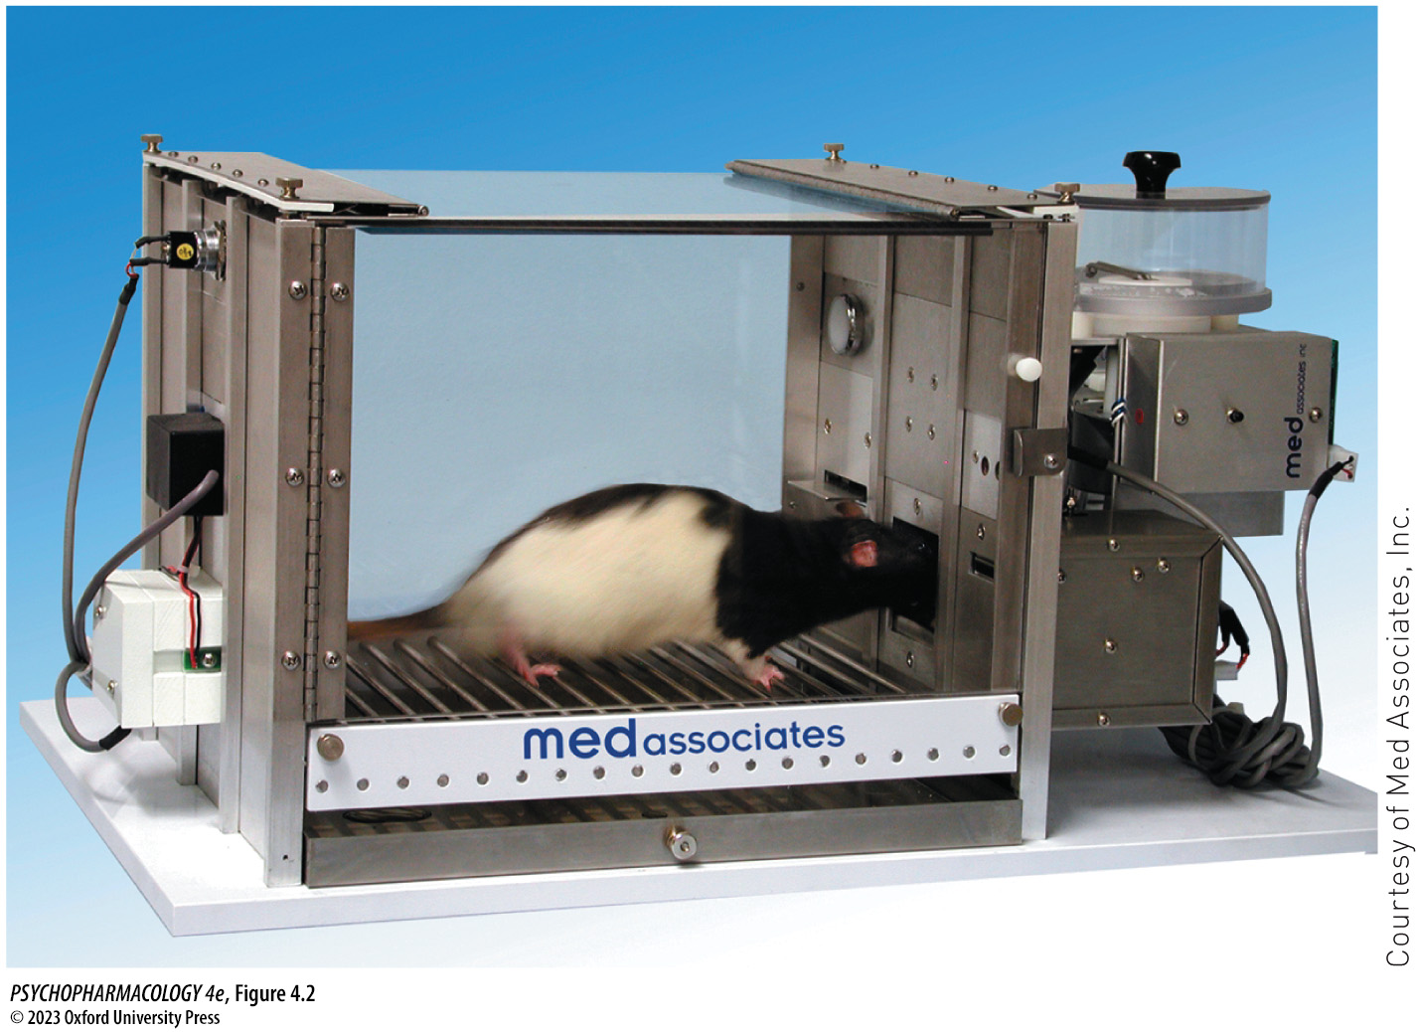
FIGURE 4.2 Rat in an operant chamber
Notes:
FIGURE 4.2 Rat in an operant chamber
The rat can be trained to press the lever (response) to activate a food delivery mechanism (reinforcement). An animal can also learn to press the lever to terminate or postpone shocks that can be delivered through the grid floor.

Slide 14
Techniques in Behavioral Pharmacology (8 of 18)
A wide variety of behaviors are evaluated by psychopharmacologists
In operant conditioning, the animal learns a response (e.g., pressing a lever) to receive a food reinforcer.
Once the behavior is learned, requirements for reinforcement can be altered according to a schedule of reinforcement.
  Fixed-ratio (FR) schedule: reinforcement is delivered after a fixed number of responses (e.g., FR-3 schedule—animal must press the lever three times)
  Fixed-interval (FI) schedule: reinforcement after a fixed amount of time
Notes:
Instructor Notes:

Slide 15
Techniques in Behavioral Pharmacology (9 of 18)
A wide variety of behaviors are evaluated by psychopharmacologists
Measures of analgesia (reduction of perceived pain without loss of consciousness):
  Tail-flick test: measures response of the animal to heat applied to the tail
  Hot plate test: animal is placed in a cylinder on a hot plate, and temperature is increased
  Operant analgesia testing: uses negative reinforcement
Notes:
Instructor Notes:

Slide 16
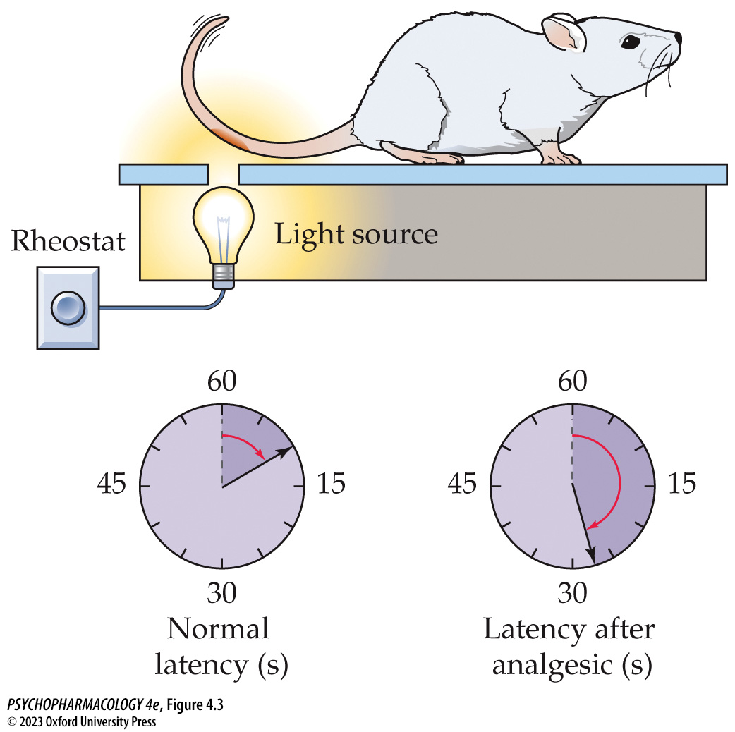
FIGURE 4.3 The tail-flick test of analgesia
Notes:
FIGURE 4.3 The tail-flick test of analgesia
The response of the animal to a thermal stimulus is measured with this test. The quantitative measure made is the time between onset of the light beam, which provides heat, and movement of the tail. The clockfaces show that the response to the noxious stimulus is delayed after treatment with an analgesic that is known to reduce pain in humans. (After L. W. Hamilton and C. R. Timmons. 1990. Principles of Behavioral Pharmacology: A Biopsychological Perspective. Prentice Hall: Englewood Cliffs, NJ.)

Slide 17
Techniques in Behavioral Pharmacology (10 of 18)
A wide variety of behaviors are evaluated by psychopharmacologists
Tests of learning and memory: tests depend on presentation of information (training) and after a delay, the performance (test)
Mazes: learning is evaluated based on number of errors at choice points and/or time taken to reach the goal box
Delayed-response test: similar to the Wechsler Memory Scale used to evaluate working memory deficits in humans
Notes:
Instructor Notes:
Mazes: T-maze, multiple T-maze, radial arm maze, Morris water maze
Drugs may alter the animal’s memory or behavior but can also make it more or less hungry, sedated, disoriented, etc

Slide 18
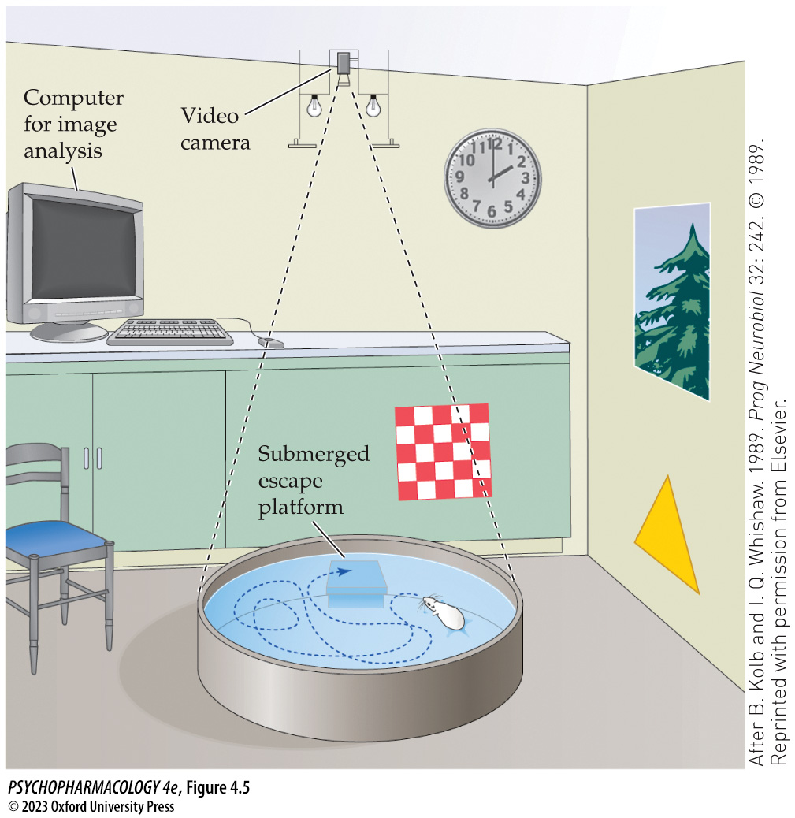
FIGURE 4.5 The Morris water maze
Notes:
FIGURE 4.5 The Morris water maze
A circular pool is filled with opaque water. The escape platform is approximately 1 cm below the water level. The rat’s task is to locate the submerged, hidden platform by using visuospatial cues available in the room. A video camera is mounted above the pool and is connected to the video recorder and the computer link to trace the individual swim path. (After B. Kolb and I. Q. Whishaw. 1989. Prog Neurobiol 32: 242. © 1989. Reprinted with permission from Elsevier.)

Slide 19
Techniques in Behavioral Pharmacology (11 of 18)
A wide variety of behaviors are evaluated by psychopharmacologists
Measures of anxiety-like behaviors: most use induced fearfulness as an analogy to human anxiety (e.g., light–dark crossing task; open field test; elevated plus-maze; one-chamber social interaction test; novelty suppressed feeding paradigm; water-lick suppression test (Vogel test) – a conflict procedure; defensive burying and marble burying tasks)
Notes:
Instructor Notes:
Zero maze: donut-shaped elevated platform. The circular construction lacks the ambiguous central square area in the plus-maze that sometimes makes scoring difficult.
In very young animals, anxiety-like behavior can be evaluated by recording and quantifying the ultrasonic vocalizations of rat pups when separated from their mothers. These vocalizations are very sensitive to a variety of antianxiety drugs.

Slide 20
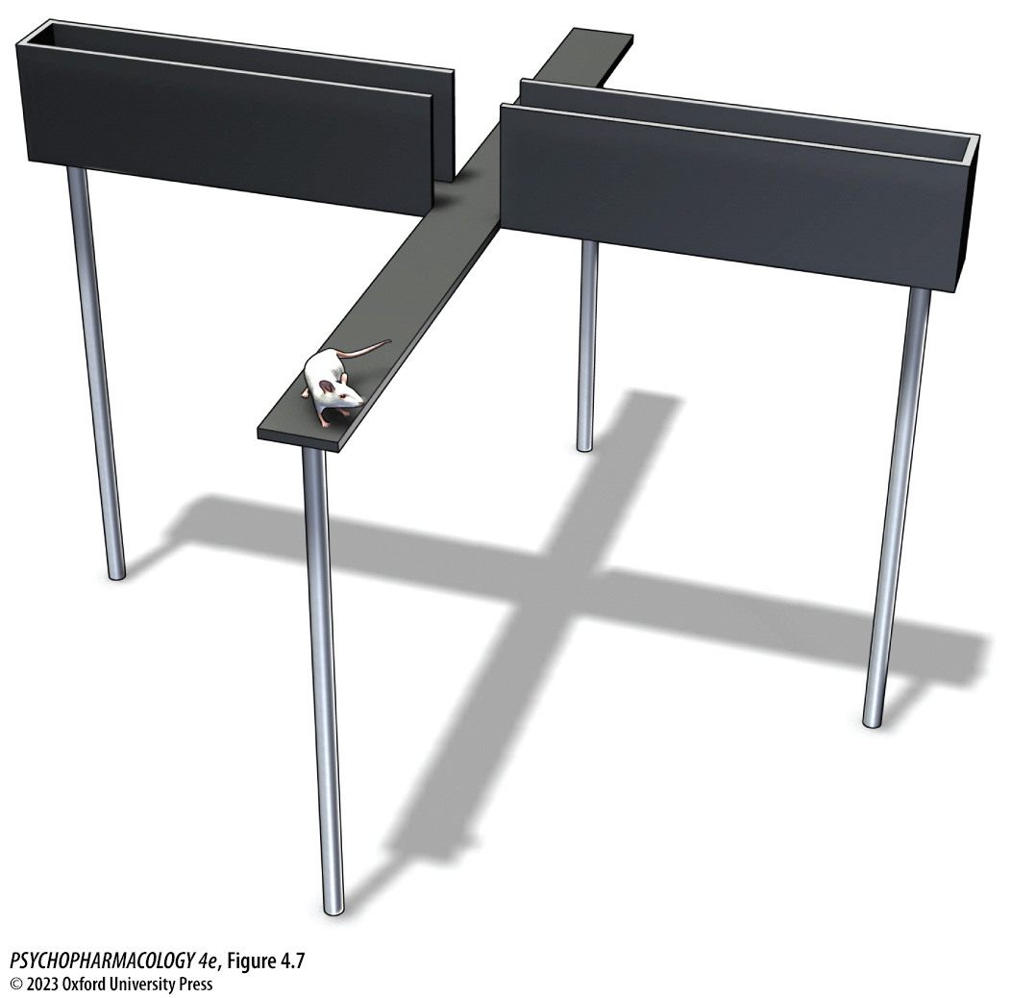
FIGURE 4.7 The elevated plus-maze
Notes:
FIGURE 4.7 The elevated plus-maze
This maze is used to test anxiety and is based on rodents’ natural aversion to heights and open space and their predisposition for enclosed places.

Slide 21
Techniques in Behavioral Pharmacology (12 of 18)
A wide variety of behaviors are evaluated by psychopharmacologists
Measures of fear (e.g., conditioned emotional response, fear-potentiated startle)
Measures of depressive-like behavior (e.g., behavioral despair or forced swim test, tail suspension test, learned helplessness)
Notes:
Instructor Notes:
Example of fear-potentiated startle: If a light has been paired with a foot shock, presentation of the light increases the magnitude of the startle response to a novel stimulus, such as a loud clap.
Forced swim test and tail suspension text both assume that immobility reflects a lowered mood; the animals are resigned to their fate and have given up hope.

Slide 22
Techniques in Behavioral Pharmacology (13 of 18)
A wide variety of behaviors are evaluated by psychopharmacologists
Tests of chronic stress:
  Chronic mild unpredictable stress
  Chronic social defeat stress
  Maternal separation
  Sucrose preference test – measures anhedonia
Notes:
Instructor Notes:

Slide 23
Techniques in Behavioral Pharmacology (14 of 18)
A wide variety of behaviors are evaluated by psychopharmacologists
Methods of assessing drug reward and reinforcement:
  Drug self-administration method
  Electrical self-stimulation
  Breakpoint
  Conditioned place preference
  Drugs as discriminative stimuli
Notes:
Instructor Notes:
Electrical self-stimulation: animal self-administers a weak electrical current to discrete brain areas via an indwelling electrode. Release of neurotransmitters mediate a reinforcing effect.
Breakpoint: point at which the effort required to get the drug exceeds the reinforcing value

Slide 24
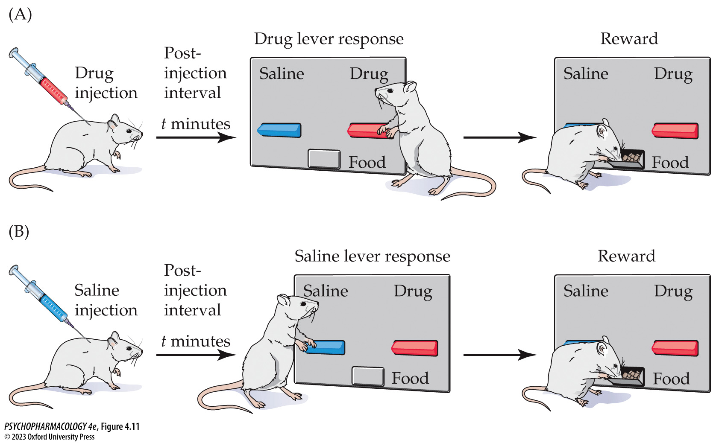
FIGURE 4.11 Drug discrimination testing
Notes:
FIGURE 4.11 Drug discrimination testing
(A) A rat is injected with a drug before being placed in an operant chamber. If it presses the right lever (“drug”), it receives a food reward. If it presses the left (saline) lever, no reinforcement occurs. (B) On days that the rat receives a saline injection before it is placed in the operant chamber, it receives food reinforcement if it presses the saline lever, and no reinforcement if it presses the drug lever. Discrimination of internal drug cues determines the animal’s response.

Slide 25
Techniques in Behavioral Pharmacology (15 of 18)
A wide variety of behaviors are evaluated by psychopharmacologists
New technologies such as computer vision are used to quantify behavior.
Artificial intelligence algorithms are used to analyze video recordings of animals in habitat-based test environments.
Behavioral data is also collected from humans, using commonly available wearable sensor technology.
Notes:
Instructor Notes:

Slide 26
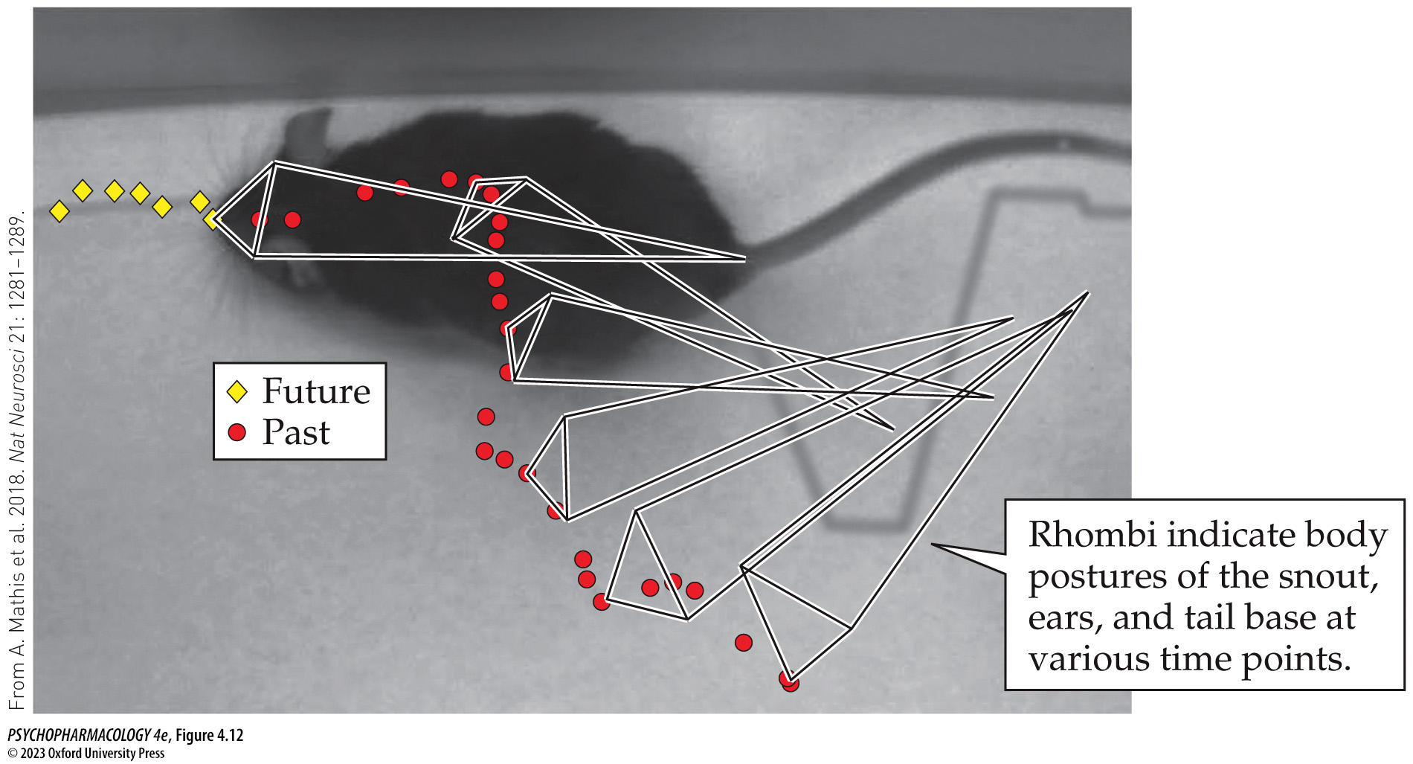
FIGURE 4.12 Automated analysis of behavior with computer vision (1)
Notes:
FIGURE 4.12 Automated analysis of behavior with computer vision
An example video frame capture showing a mouse engaged in locomotor behavior. The polygons are generated by highly specialized software and represent the relative position and orientation of the mouse at various earlier time points, while the red circles and yellow diamonds depict the snout position of the mouse at both earlier and future time points, respectively. By encoding the position, orientation, and posture of the mouse over time, on a frame-by-frame basis, complex algorithms can be applied to detect behavioral patterns that reflect both phenotype and subtle drug treatment effects.

Slide 27
Techniques in Behavioral Pharmacology (16 of 18)
A wide variety of behaviors are evaluated by psychopharmacologists
Translational research: transforming discoveries from basic neuroscience research into clinical applications
Because human clinical trials are lengthy and expensive, recent emphasis has been on improving predictability of therapeutic drug effects based on animal research.
Notes:
Instructor Notes:

Slide 28
Techniques in Behavioral Pharmacology (17 of 18)
BOX 4.1 CLINICAL APPLICATIONS
Drug Testing for FDA Approval
All new drugs produced and sold in the United States must be approved by the Food and Drug Administration (FDA).
They must be demonstrated to be both effective and safe.
About 20% of new drugs being tested reach final approval, and 80% are eliminated.
Notes:
Instructor Notes:

Slide 29
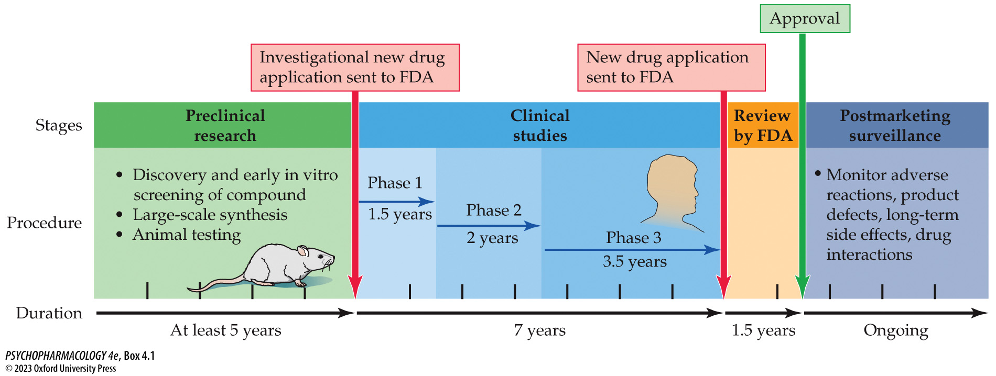
Box 4.1 Clinical Applications: Drug Testing for FDA Approval
Notes:
Box 4.1 Clinical Applications: Drug Testing for FDA Approval

Slide 30
Techniques in Behavioral Pharmacology (18 of 18)
CLICKER QUESTION 1
Which of the following is a test for depressive-like behavior?
Elevated-plus maze
Forced swim test
Light-dark crossing task
Catalepsy test
Notes:
Instructor Notes:
Correct answer: b

Slide 31
Review of Learning Objectives (1 of 3)
4.1.1 Describe the advantages of using animal subjects over human participants in neurobiological research.
4.1.2 Describe how researchers evaluate and optimize behavioral tests in non-human animals with respect to face, predictive, and construct validity.
4.1.3 Identify and describe animal behavior tests commonly used to evaluate learning and memory; analgesia; anxiety- and depression-like behavior; and the abuse liability of drugs.
4.1.4 Describe how technological advances in bioinformatics, such as computer vision, can be utilized to describe behavioral signatures of drug effects.

Slide 32
Techniques in Neuropharmacology (1 of 20)
Multiple neurobiological techniques are necessary for the most productive research in psychopharmacology.
Stereotaxic surgery is needed for accurate in vivo measures of brain function:
  Devices can be implanted in the brain with precision
  Brain site coordinates are calculated using a brain atlas
  A similar apparatus is used for human brain surgery
Notes:
Instructor Notes:

Slide 33
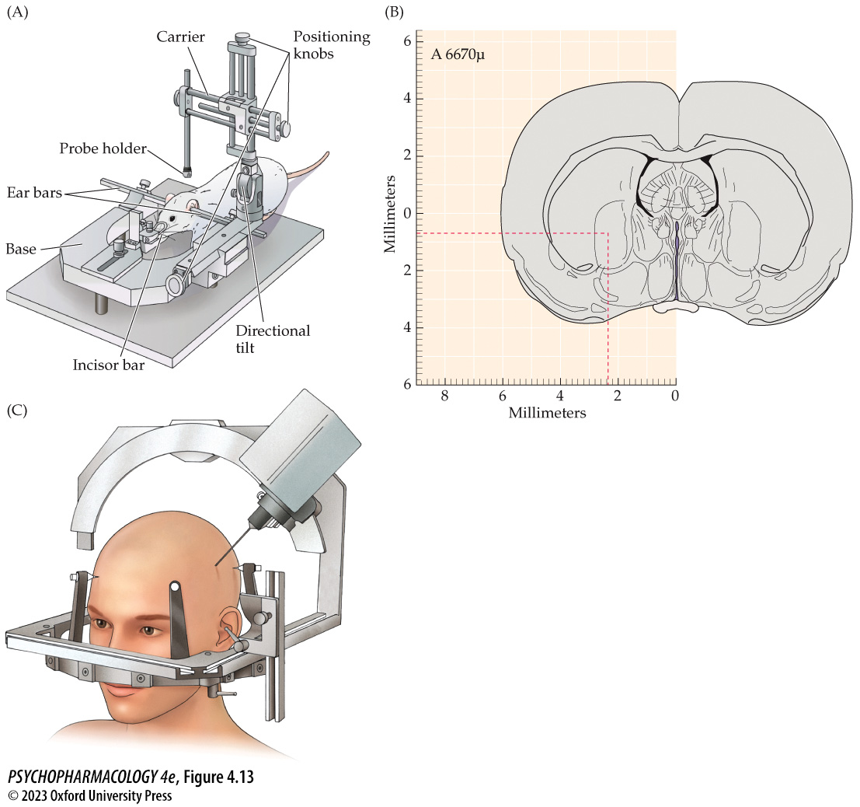
FIGURE 4.13 Stereotaxic surgery
Notes:
FIGURE 4.13 Stereotaxic surgery
(A) A stereotaxic device used for precise placement of electrodes during brain surgery on animals. The base holds the anesthetized animal’s head and neck in a stationary position. The carrier portion places the electrode or the cannula in a precise location based on the coordinates of the target area identified with the brain atlas (B). The precise target within the brain is defined by the intersection of three planes. The measurement (A 6670μ) in the upper left corner indicates the anterior–posterior position of the brain slice. The lateral and dorsal–ventral dimensions can be read directly from the axes provided. (C) A similar apparatus is used for human brain surgery. The location of the procedure is determined by CT or MRI.

Slide 34
Techniques in Neuropharmacology (2 of 20)
Stereotaxic surgery is needed for accurate in vivo measures of brain function
Lesioning: an electrode is inserted to destroy brain tissue; behavior before and after is evaluated
Neurotoxins can be injected via a cannula to destroy cells
Cannulas can be used to administer drugs or neuro-transmitters that stimulate cells
Specific neurotoxins are for different neural pathways that use particular neurotransmitters
Notes:
Instructor Notes:
Cannula: a hollow tube inserted like an electrode

Slide 35
Techniques in Neuropharmacology (3 of 20)
Stereotaxic surgery is needed for accurate in vivo measures of brain function
Microdialysis: measurement of neurotransmitters released in a specific brain region while the subject is actively engaged in behavior
In vivo voltammetry: implanted microelectrodes measure neurochemicals in extracellular fluid of freely moving animals
Notes:
Instructor Notes:
The CSF is collected for analysis by high-performance liquid chromatography (HPLC) or other method. HPLC separates the sample into component parts depending on molecular size or ionic charge. The concentration of the molecules of interest can be determined

Slide 36
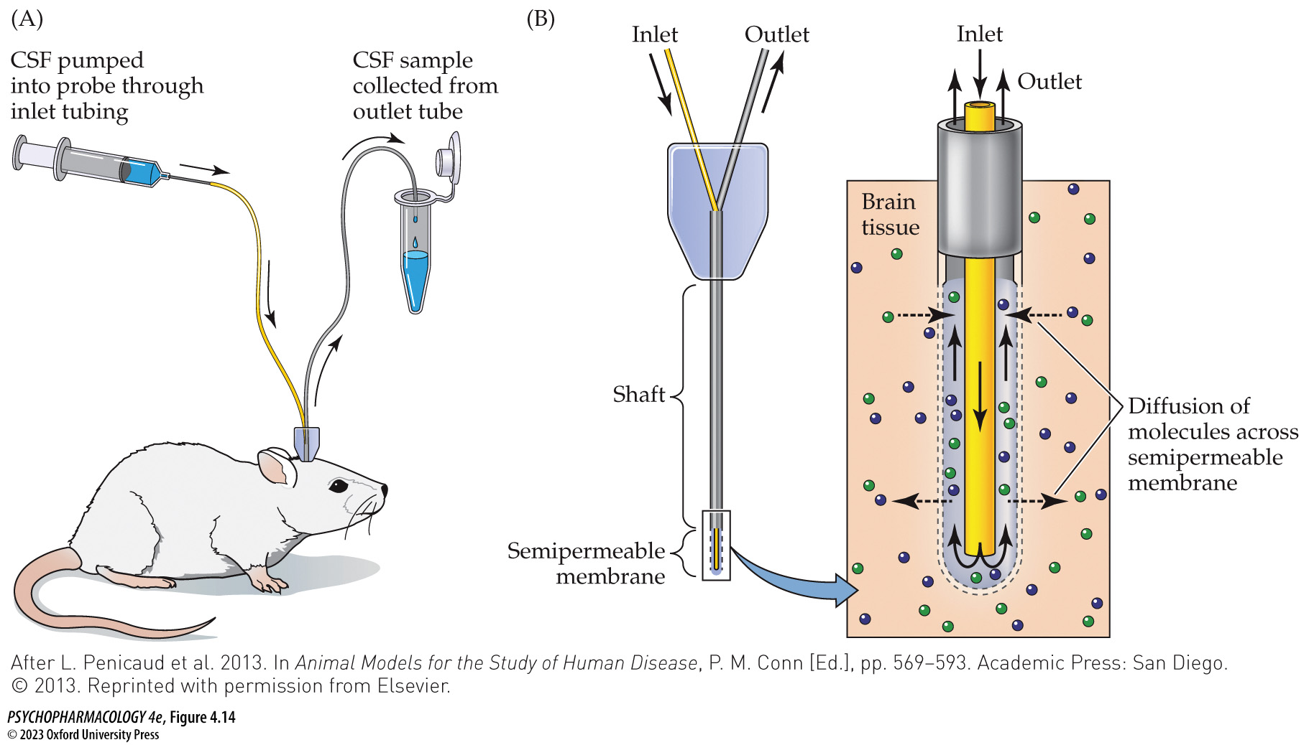
FIGURE 4.14 Sampling of extracellular fluid with microdialysis
Notes:
FIGURE 4.14 Sampling of extracellular fluid with microdialysis
(A) Microdialysis allows the collection of samples from deep within the brain in unanesthetized and freely moving animals under relatively normal conditions. The collected samples are identified and are measured by one of several analytic techniques, such as high-performance liquid chromatography (HPLC; not shown). (B) Typical microdialysis probe, which uses flexible tubing that is sealed except at the tip, where it is semipermeable. It is held in place by dental plastic on the animal’s skull. CSF, cerebrospinal fluid. (After L. Penicaud et al. 2013. In Animal Models for the Study of Human Disease, P. M. Conn [Ed.], pp. 569–593. Academic Press: San Diego. © 2013. Reprinted with permission from Elsevier.)

Slide 37
Techniques in Neuropharmacology (4 of 20)
Stereotaxic surgery is needed for accurate in vivo measures of brain function
Implanted macroelectrodes: electrical stimulation produces effects similar to neurotransmitter injection
Can also record summated electrical response of thousands of neurons in a specific brain region
Have been adapted to treat Parkinson’s disease – small pulses of electrical current applied to the subthalamic nucleus reduces tremor
Notes:
Instructor Notes:

Slide 38
Techniques in Neuropharmacology (5 of 20)
Stereotaxic surgery is needed for accurate in vivo measures of brain function
Microelectrodes can be implanted into a single cell (intracellular recording) or into the extracellular fluid near a single cell (extracellular recording)
Patch clamp electrophysiology: allows study of individual ion channels
Notes:
Instructor Notes:
Patch clamp electrophysiology involves attaching a recording micropipette to a piece of cell membrane by suction; records channel opening and closing, and flow of ions.

Slide 39
Techniques in Neuropharmacology (6 of 20)
Neurotransmitters, receptors, and other proteins can be quantified and visually located in the CNS
“Soup” method (tissue extract assay): isolates and grinds tissue sample to form a homogenate, which can be analyzed
“Slice” method (brain slice preparation): uses intact piece or slice of tissue for visualization
Notes:
Instructor Notes:

Slide 40
Techniques in Neuropharmacology (7 of 20)
Neurotransmitters, receptors, and other proteins can be quantified and visually located in the CNS
Radioligand binding: amount of bound ligand reflects the number of receptors in the tissue.
Criteria to determine if ligand is binding to a specific receptor:
  Specificity
  Saturability
  Reversibility and high affinity
  Biological relevance
Notes:
Instructor Notes:
Specificity - very high concentrations of a nonradioactive competing ligand are added to some tubes to show that most of the radioactive binding is displaced. That which remains is
likely to be nonspecifically bound to other sites.
Saturability – increasing amounts of radioligand is added; where binding curve plateaus represents maximum binding
Reversibility - the radioactive ligand can be displaced by the same drug that is not radiolabeled.
Affinity - compare the rate of dissociation with the rate of binding to estimate receptor affinity (dissociation constant, or Kd).
Binding of chemically similar drugs should correlate with some measurable biochemical or behavioral effect to show the biological relevance of the receptor.

Slide 41
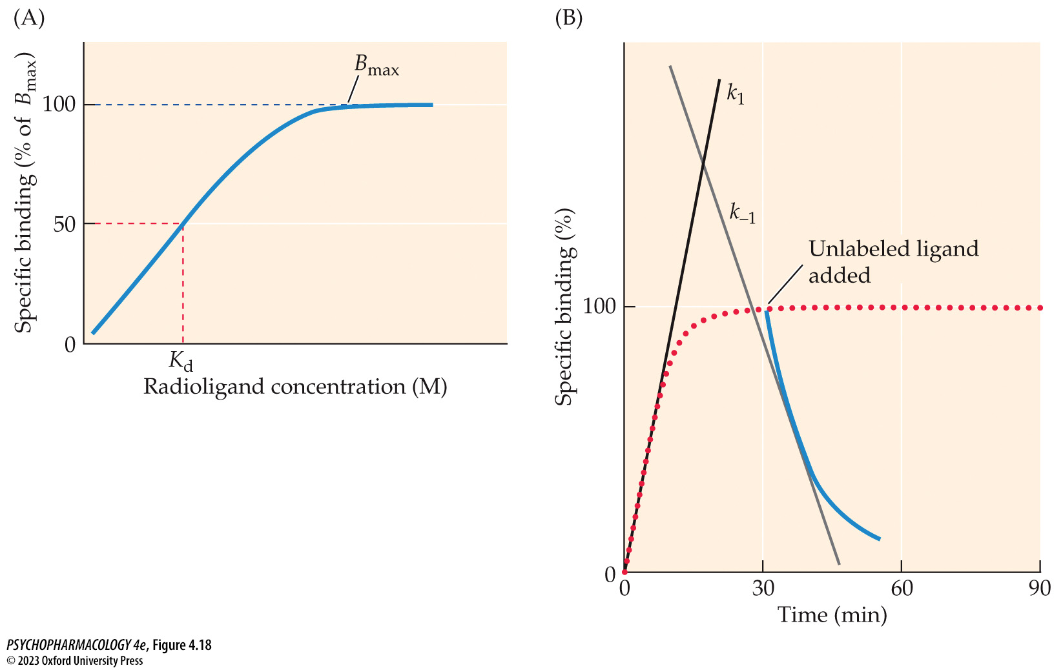
FIGURE 4.18 Radioligand binding to receptors
Notes:
FIGURE 4.18 Radioligand binding to receptors
(A) A hypothetical saturation curve shows that as radioligand concentration increases, specific binding to the receptor also increases until all sites are filled (B_{max}). The K_{d} is defined as the ligand concentration at which 50% of the receptors are occupied; it is an indication of receptor affinity and is called the dissociation constant. (B) Hypothetical association and dissociation curves. The dotted red line represents the association of a radioligand with its receptors over time. The rate of association (k₁) is estimated by calculating the slope of the straight line that best fits the curvilinear data. After maximum binding has occurred (association and dissociation are in equilibrium), excess unlabeled ligand is added. The solid blue line represents the dissociation of the radioligand from its receptors in the presence of large amounts of unlabeled ligand. The slope of the straight line that best fits that portion of the curve provides an estimate of the rate of dissociation (k₋₁).

Slide 42
Techniques in Neuropharmacology (8 of 20)
Neurotransmitters, receptors, and other proteins can be quantified and visually located in the CNS
Autoradiography: radioligand is added to a tissue slice; shows distribution of receptors in the brain.
In vivo receptor binding: animal is injected with radioligand while still alive
Notes:
Instructor Notes:

Slide 43
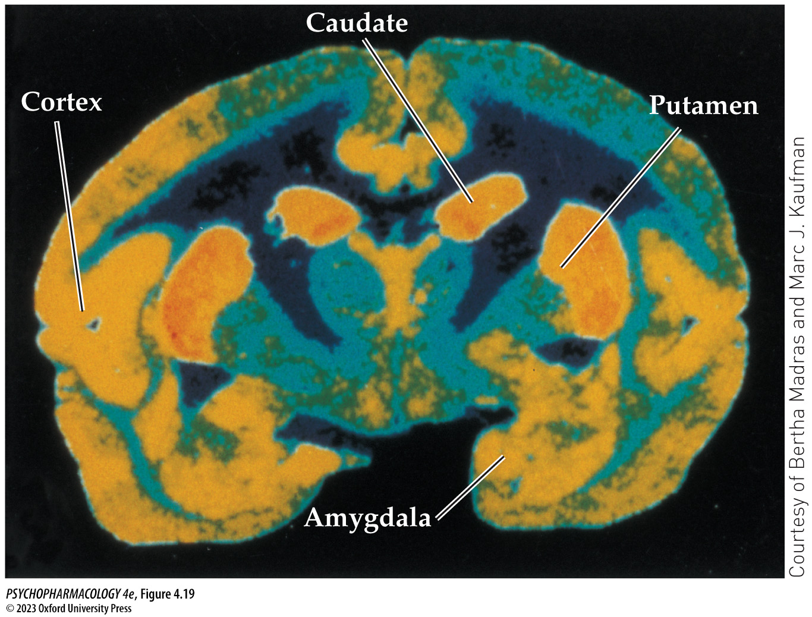
FIGURE 4.19 Autoradiogram of the distribution of cocaine binding in monkey brain
Notes:
FIGURE 4.19 Autoradiogram of the distribution of cocaine binding in monkey brain
The highest levels of cocaine binding are in areas colored yellow and orange.

Slide 44
Techniques in Neuropharmacology (9 of 20)
Neurotransmitters, receptors, and other proteins can be quantified and visually located in the CNS
Assays of enzyme activity using antibodies produced to bind to specific proteins:
  Immunocytochemistry (ICC)
  Western blot
  Radioimmunoassay (RIA)
  Enzyme-linked immunosorbent assay (ELISA)
Notes:
Instructor Notes:

Slide 45
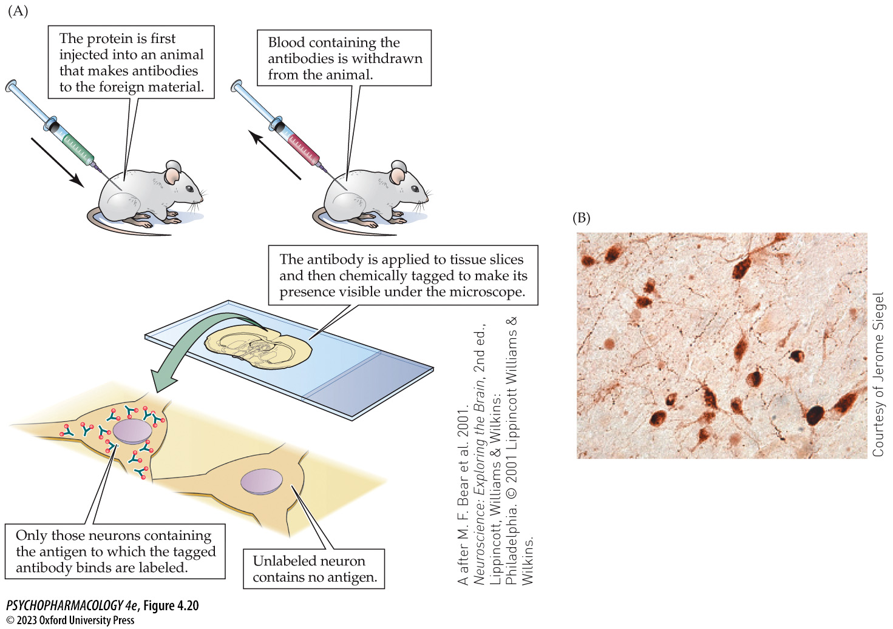
FIGURE 4.20 Immunocytochemistry (ICC) uses tagged antibodies to locate molecules within cells (1)
Notes:
FIGURE 4.20 Immunocytochemistry (ICC) uses tagged antibodies to locate molecules within cells
(A) Steps in ICC localization. (B) Immu­nocytochemical identification of cells containing the neuropeptide hypo­cretin in the human lateral hypothalamus. (A after M. F. Bear et al. 2001. Neuroscience: Exploring the Brain, 2nd ed., Lippincott, Williams & Wilkins: Philadelphia. © 2001 Lippincott Williams & Wilkins.)

Slide 46
Techniques in Neuropharmacology (10 of 20)
Neurotransmitters, receptors, and other proteins can be quantified and visually located in the CNS
In situ hybridization (ISH) - locates cells in tissue slices that are manufacturing a particular protein or peptide, such as mRNAs
DNA microarrays measure expression of thousands of genes at the same time
Genome-wide association studies (GWAS) - uses gene chips consisting of large sets of single-nucleotide polymorphisms (SNPs) to search for alleles associated with a disease or disorder
Notes:
Instructor Notes:

Slide 47
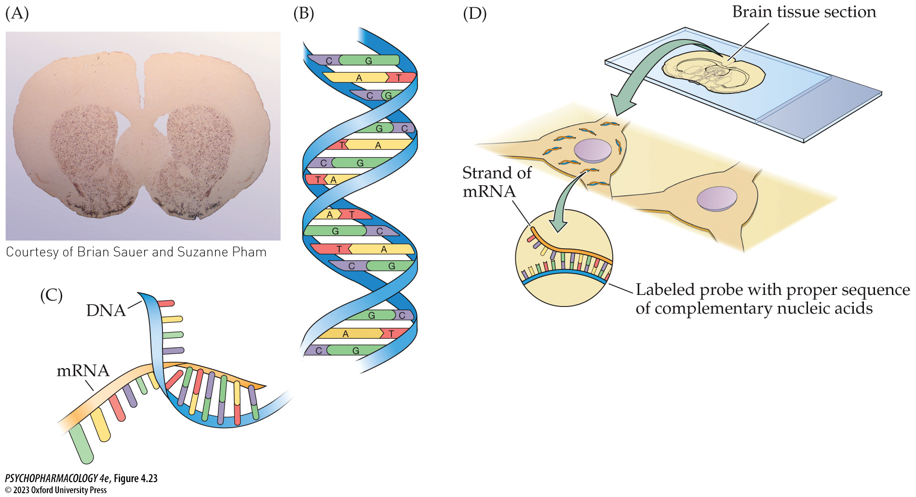
FIGURE 4.23 In situ hybridization (ISH)
Notes:
FIGURE 4.23 In situ hybridization (ISH)
(A) Localization of enkephalin mRNA in a slice from rat brain. (B) Structure of a DNA molecule. The nucleotide bases always bind in a complementary fashion: thymine to adenine, and guanine to cytosine. (C) A strand of mRNA has copied the code from a partially unraveled DNA molecule in the nucleus and will carry the genetic code to ribosomes in the cytoplasm, where the protein will be created. (D) In ISH, a labeled probe has been created with the correct sequence of complementary bases. When the strand of mRNA in the cell and the labeled probe hybridize, or bond to one another, the product will label the cell that contains the genetic code for the protein of interest.

Slide 48
Techniques in Neuropharmacology (11 of 20)
New tools are used for imaging the structure and function of the brain
Autoradiography can trace active processes in the brain such as blood flow, oxygen consumption, glucose utilization, or rates of protein synthesis that indicates neural activity
2-deoxyglucose autoradiography: based on the assumption that when nerve cell firing increases, metabolic rate increases
Notes:
Instructor Notes:
2-deoxyglucose autoradiography: uptake of a labeled, modified form of glucose shows active brain areas.

Slide 49
Techniques in Neuropharmacology (12 of 20)
New tools are used for imaging the structure and function of the brain
Imaging techniques:
  Computerized tomography (CT)
  Magnetic resonance imaging (MRI)
  Magnetic resonance spectroscopy (MRS)
  Diffusion tensor imaging (DTI)
  Positron emission tomography (PET)
Notes:
Instructor Notes:

Slide 50
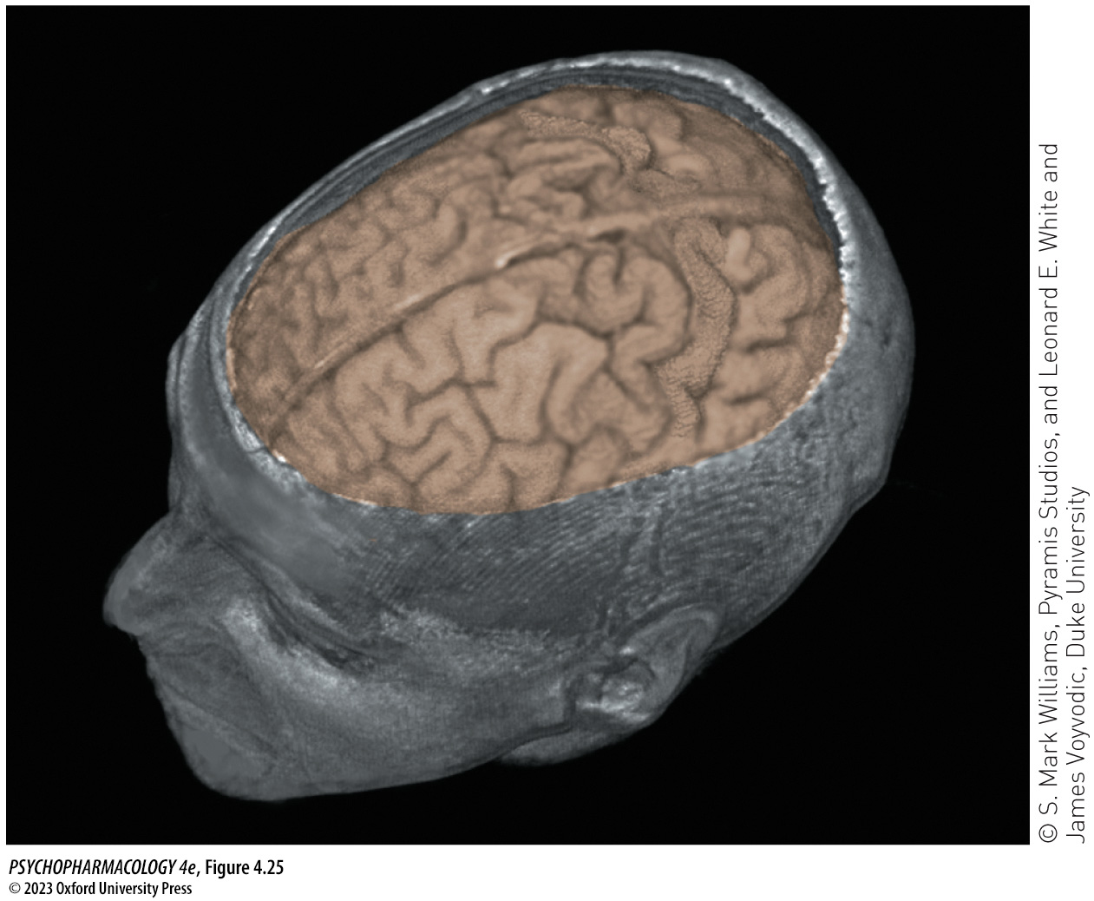
FIGURE 4.25 A three-dimensional image formed with MRI
Notes:
FIGURE 4.25 A three-dimensional image formed with MRI
Computer technology provides the opportunity to create three-dimensional representations of the brain from sequential slices.

Slide 51
Techniques in Neuropharmacology (13 of 20)
New tools are used for imaging the structure and function of the brain
Imaging techniques:
  Single-photon emission computerized tomography (SPECT)
  Functional MRI (fMRI)
  Resting-state fMRI (rs-fMRI)
  Electroencephalography (EEG)
  Quantitative EEG (qEEG)
Notes:
Instructor Notes:

Slide 52
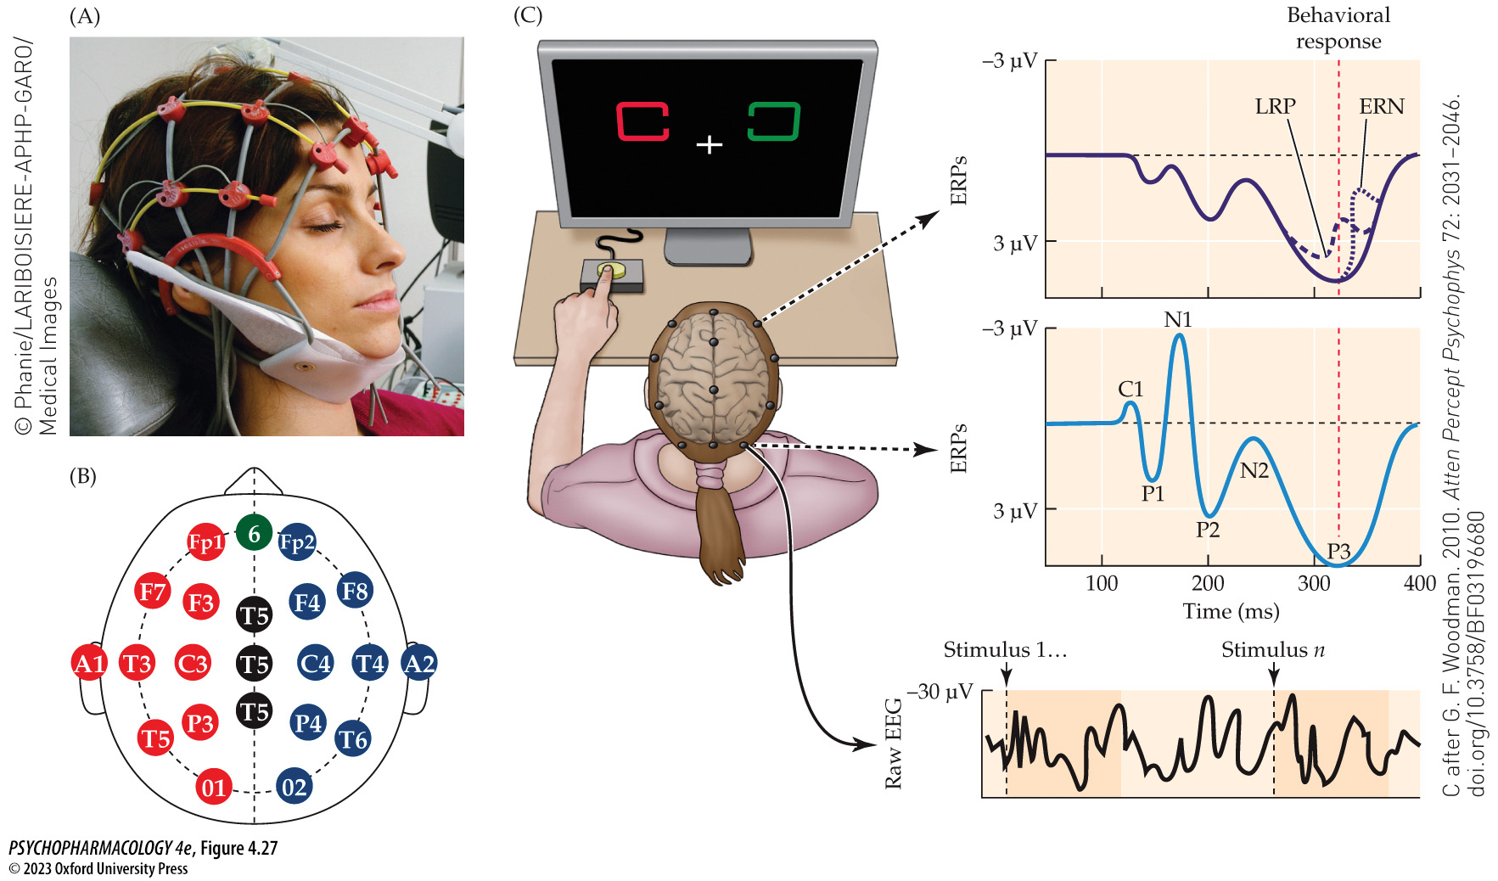
FIGURE 4.27 Electroencephalography (EEG)
Notes:
FIGURE 4.27 Electroencephalography (EEG)
(A) In humans, changes in electrical activity of the brain are detected by recording electrodes that are attached to the surface of the individual’s scalp. The electrodes record the activity of thousands of cells simultaneously. (B) The standardized international 10–20 system for electrode placement, with the view of the skull from above, nose indicating frontal, ears to each side. The electrodes are marked as the ground (G), frontal pole (Fp), frontal (F), central (C), parietal (P), occipital (O), and temporal (T). The midline electrodes are marked as FZ, CZ, and PZ, with the Z standing for zero. Odd numbers are used for points over the left hemisphere, and even numbers over the right. The ear lobes are indicated with (A). (C) Event-related potential (ERP) patterns of voltage change in response to a visual stimulus in a discrimination task. On the left is a model of a human head with the placement of a subset of electrodes from the 10–20 system. The right side of the figure shows how the ERPs are extracted from the raw EEG record while the subject performs the visual discrimination task. The lower ERP (blue) shows the wave forms at occipitotemporal lobe electrode sites during the visual task. The upper ERP (purple) shows the wave forms while the finger response occurs. Processes associated with voltage fluctuations of the ERP are labeled: C1, primary visual cortex; P1 and N1, information moves through the visual system; P2, not well understood; N2, categorizing the stimulus; P3 (often called P300 because it occurs 300 ms after the stimulus onset), working memory encoding; LRP, preparation for the motor response; ERN, evaluation of performance after the response. (C after G. F. Woodman. 2010. Atten Percept Psycho­phys 72: 2031–2046. doi.org/10.3758/BF03196680)

Slide 53
Techniques in Neuropharmacology (14 of 20)
Genetic engineering helps neuroscientists to ask and answer new questions
DNA of an organism is altered to produce highly specific mutations.
Knockout mice: lack gene for making a particular protein
Knockin mice: inserted gene is modified to produces a slightly different protein
Transgenic mice: one gene has been substituted for another
Notes:
Instructor Notes:
Genetic material can be inserted into cells in cell culture that don’t normally have a particular protein (e.g., receptor). The normal cell division process produces large numbers of identically altered cells, called cloning.

Slide 54
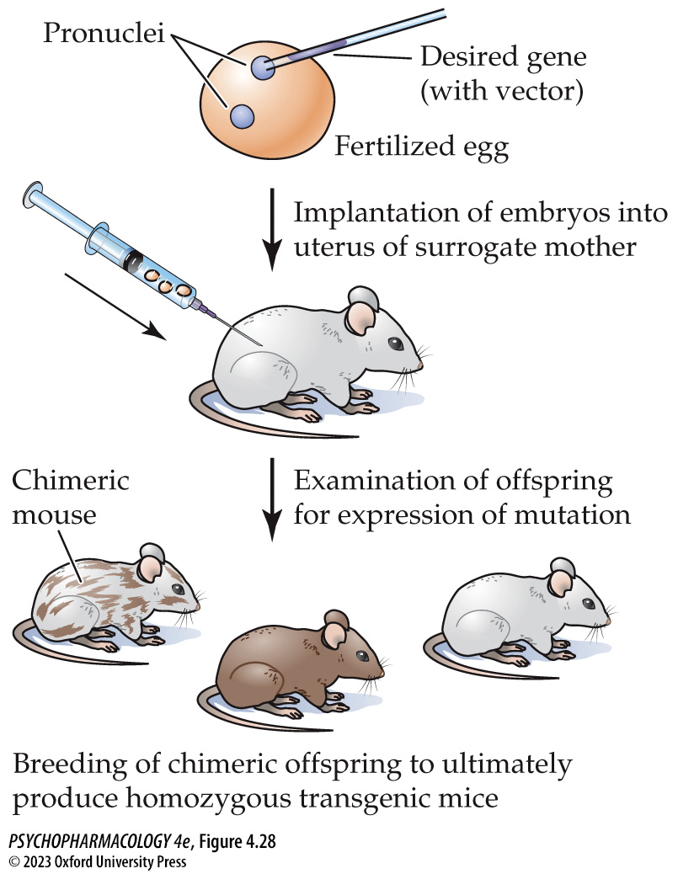
FIGURE 4.28 Illustration of genetic engineering
Notes:
FIGURE 4.28 Illustration of genetic engineering
Genetic material is extracted from cells, injected into fertilized eggs, and implanted in the uterus of a surrogate mother. Offspring that are chimeric are mated with wild-type mice. Any of their offspring that are heterozygous for the genetic trait of interest are subsequently mated to produce some homozygous mice of interest.

Slide 55
Techniques in Neuropharmacology (15 of 20)
Genetic engineering helps neuroscientists to ask and answer new questions
CRISPR (clustered regularly interspaced short palindromic repeat) – faster way to genetically engineer mice
“Guide RNA” identifies a specific genomic sequence to be modified, and a nuclease (Cas9) cuts out the specified section. New DNA is then inserted.
Notes:
Instructor Notes:

Slide 56
Techniques in Neuropharmacology (16 of 20)
BOX 4.3 PHARMACOLOGY IN ACTION
Transgenic Model of Huntington’s Disease
In a transgenic mouse model for Huntington’s disease, motor functioning was evaluated using beam walking, rotarods, swimming ability, gait, and other measures.
Comparison with wild-type mice showed progressive loss of motor ability in the transgenic mice.
Behavioral measures that reflect the symptoms of Huntington’s show that R6/2 (transgenic) mice are a valid model for this disease.
The mice can be used to test potential drugs for treatment.
Notes:
Instructor Notes:
The acoustic startle response is normally reduced when the intense stimulus is preceded by a small prepulse stimulus. Patients with HD characteristically show a deficit in that prepulse
inhibition of startle.

Slide 57
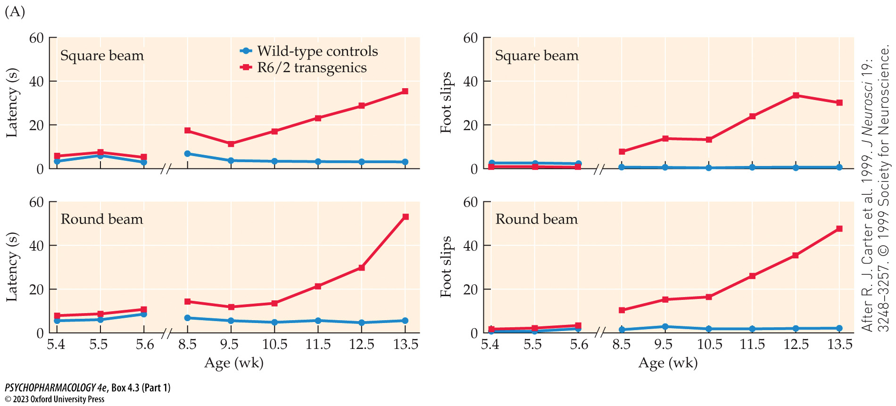
BOX 4.3 Pharmacology in Action: Transgenic Model of Huntington’s Disease (Part 1)
Notes:
Box 4.3 Pharmacology in Action: Transgenic Model of Huntington’s Disease
FIGURE A Beam walking
Mice were taught to walk across square or round elevated beams to reach an enclosed safety platform. The time to cross and the number of foot slips were recorded. Each data point represents the mean time to cross. (After R. J. Carter et al. 1999. J Neurosci 19: 3248–3257. © 1999 Society for Neuroscience.)

Slide 58
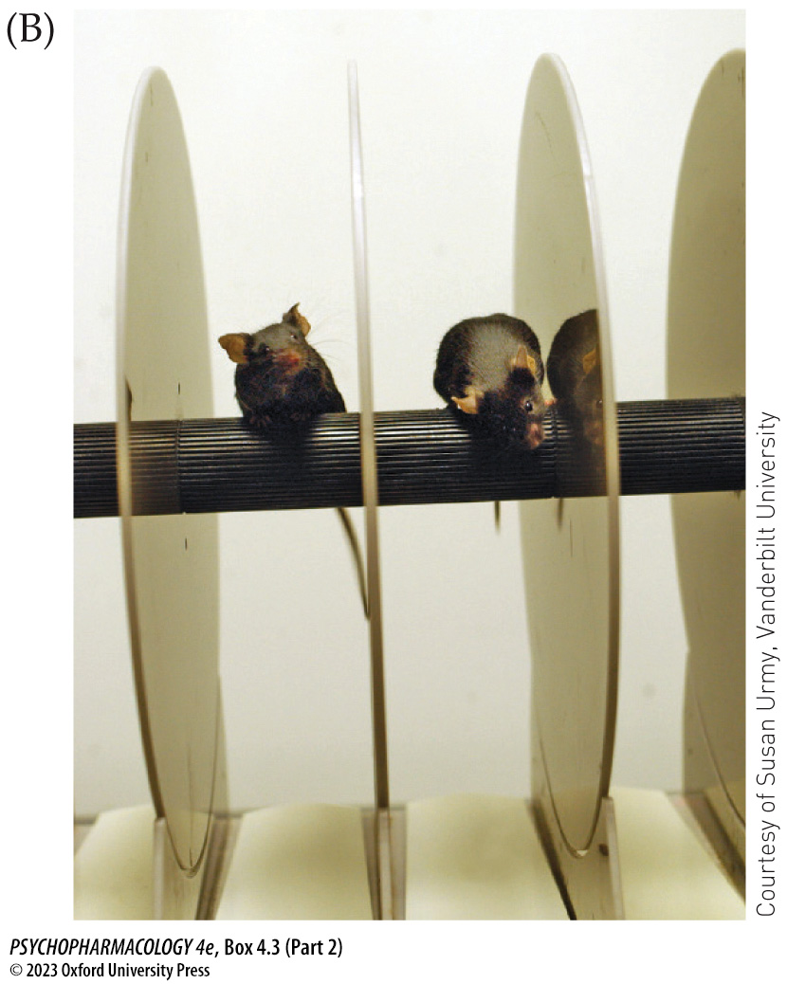
BOX 4.3 Pharmacology in Action: Transgenic Model of Huntington’s Disease (Part 2)
Notes:
Box 4.3 Pharmacology in Action: Transgenic Model of Huntington’s Disease
FIGURES B,C Rotarod performance
Data points represent the mean latency to fall from the rotarod (maximum trial length = 60 seconds) at various speeds of rotation. rpm, revolutions per minute. (After R. J. Carter et al. 1999. J Neurosci 19: 3248–3257. © 1999 Society for Neuroscience.)

Slide 59
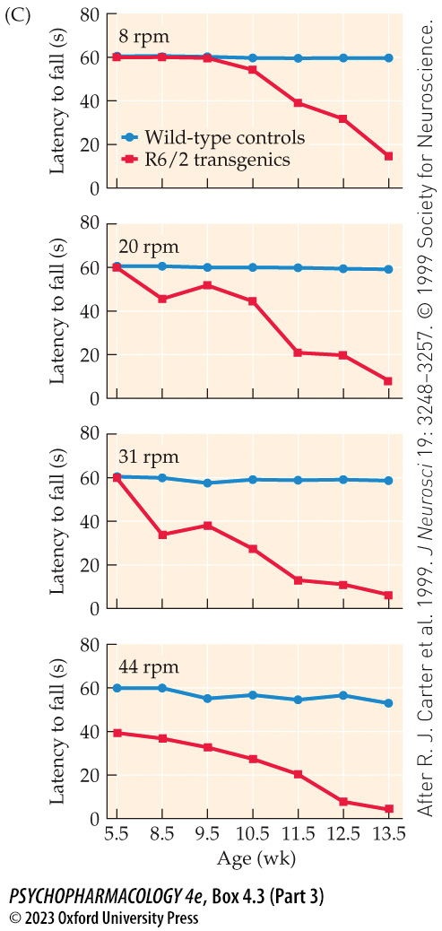
BOX 4.3 Pharmacology in Action: Transgenic Model of Huntington’s Disease (Part 3)
Notes:
Box 4.3 Pharmacology in Action: Transgenic Model of Huntington’s Disease
FIGURES B,C Rotarod performance
Data points represent the mean latency to fall from the rotarod (maximum trial length = 60 seconds) at various speeds of rotation. rpm, revolutions per minute. (After R. J. Carter et al. 1999. J Neurosci 19: 3248–3257. © 1999 Society for Neuroscience.)

Slide 60
Techniques in Neuropharmacology (17 of 20)
Genetic engineering helps neuroscientists to ask and answer new questions
Optogenetics: uses light and microbial opsins to exert precise control over genetically specified cells
Researchers can excite or inhibit selected populations of nerve cells almost instantaneously
Genes for the opsins can be inserted into specific neurons using viral vectors.
Notes:
Instructor Notes:

Slide 61
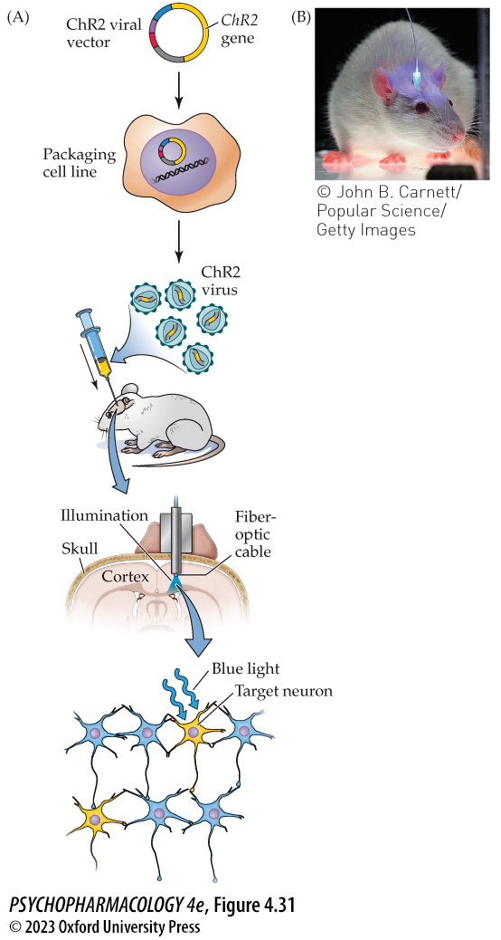
FIGURE 4.31 Behavioral control using optogenetics
Notes:
FIGURE 4.31 Behavioral control using optogenetics
(A) The steps required for an in vivo ChR2 optogenetic study include packaging the ChR2 gene along with an additional cell-targeting DNA sequence into a viral vector, growing many copies of the engineered virus, implanting the virus into a selected brain area, and stimulating the target neurons that have incorporated the ChR2 gene with a blue light. (B) Mouse implanted with a fiber-optic probe connected to a laser chosen to deliver light of the appropriate wavelength. (A from K. Deisseroth. 2015. Nat Neurosci 18: 1213–1225. doi.org/10.1038/nn.4091)

Slide 62
Techniques in Neuropharmacology (18 of 20)
Genetic engineering helps neuroscientists to ask and answer new questions
Chemogenetics or DREADD (designer receptor exclusively activated by a designer drug): A genetically engineered receptor is inserted into specific brain cells, then is activated or suppressed by a ligand that was created to specifically bind to the inserted receptor and nothing else.
Notes:
Instructor Notes:

Slide 63
Techniques in Neuropharmacology (19 of 20)
Behavioral and neuropharmacological methods complement one another
Several techniques are used in tandem to approach a problem in neuroscience from several directions.
When used together we can uncover the neurobiological substrates of cognitive function and dysfunction.
Notes:
Instructor Notes:

Slide 64
Techniques in Neuropharmacology (20 of 20)
CLICKER QUESTION 2
Which technique allows researchers to study a single ion channel?
Intracellular recording
Microdialysis
Patch-clamp electrophysiology
Autoradiography
Notes:
Instructor Notes:
Correct answer: c

Slide 65
Review of Learning Objectives (2 of 3)
4.2.1 Describe how stereotaxic surgery can be used in combination with a brain atlas to accurately target brain structures using a three-dimensional coordinate system.
4.2.2 Explain how neural activity can be monitored in awake, behaving animals. Compare and contrast neurochemical techniques, such as microdialysis and in vivo voltammetry with electrophysiological techniques.
4.2.3 Describe the similarities and differences between radiolabeling assays and techniques that use immunocytochemistry (ICC).Provide examples of how these techniques are typically used in neuropharmacology research.
4.2.4 Identify and describe various tools used for detecting gene expression and transcription levels, including in situ hybridization (ISH), DNA microarrays, and RNA sequencing (RNA-seq).

Slide 66
Review of Learning Objectives (3 of 3)
4.2.5 Describe the different brain imaging technologies, with particular emphasis on the relative advantages and disadvantages of each, with respect to their utility in neuropharmacology. Identify the advantages and disadvantages of electroencephalogram (EEG) technology relative to these imaging techniques.
4.2.6 Identify different genetic engineering technologies, including transgenic, knockout and knockin techniques, as well as optogenetic and DREADD technology and describe how they are useful for psychopharmacology research. Furthermore, explain how CRISPR technology has improved upon existing gene-editing techniques, and identify ethical issues associated with its potential use in humans.

